Slide 1
EEE/GEF 455/457
Design Projects
Projets de conception
Maj Drolet
Capt Chisholm
Notes:
Introduction
Everyone present?
Any 3rd years not part of the class?

Slide 2
Outline
Aim
Deliverables and Schedule
Organization
Selecting a project
Web site
Résumé
Aim
Principaux livrables et Horaire
Organisation
Sélection d’un projet
Site Web
Notes:
Outline of what we are going to talk about today
What you are expected to do throughout the course
What you will deliver and when
How the course is organized
Info about potential projects
And link to the website to provide more info.

Slide 3
Aim of course
 Define a problem
 Apply engineering process
 Produce design
 Implement
 Validate
 Communicate
Objectifs du cours
 Définir un problème
 Appliquer le processus de génie
 Faire la conception
 Implémenter
 Valider
 Communiquer
Notes:
Aim of the course itself
Big part is planning!
People have issues with coming up with a design and than building it. They rather build as we go
Being an engineer means you need to come up with a plan/design before building
Nobody will let you build things in the real-world without a plan (cost)
So this course is here to help that.
Here is the steps…
Opportunity to apply all the engineering material you have learned throughout your studies at RMC.
You have already learned these steps
But we will refresh your memory as we go.

Slide 4
Schedule / Horaire
Notes:
Year long course will you will be expect to produce several engineering products and documentation throughout.

Slide 5
Organization / Organisation
Bureau de gestion de projet PMO
Superviseur
Supervisor
Superviseur
Supervisor
Superviseur
Supervisor
Étudiants
Students
Étudiants
Students
Étudiants
Students
Étudiants Students
Étudiants
Students
Étudiants
Students

Slide 6
Organization
Organisation
Étudiants divisés en groupes de 2 à 3
Chaque groupe a un superviseur
Le superviseur est spécialiste dans le domaine
Le bureau de gestion de projet (BGP) supervise tous les projets
Students break into groups of 2 to 3
Each group must find a supervisor
Supervisor serves as engineering supervisor and Subject Matter Expert throughout Project.
Project Management Office (PMO) oversees all projects
Notes:
You can’t work alone
Technical vs Project Management

Slide 7
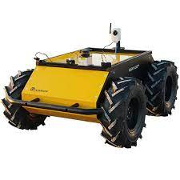
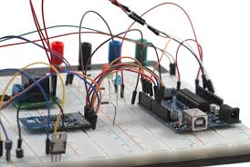
Potential Project Topics
Robotics / Drones
Avionics Bus
Microcontrollers
Radar / EW
Cyber / Malware
Robotique / Drones
Bus avionique
Microcontrôleurs
Radar / Guerre Electronique
Cyber/Malware

Slide 8
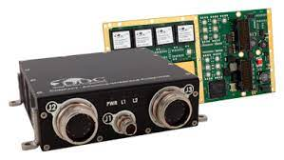
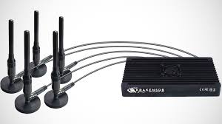
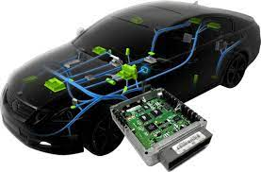
Sujets de projet potentiels
Machine Learning
Real-time Systems
External DND sponsored project
And many Others!!!
Apprentissage machine
Systèmes en temps réel
Project externe parrainé par le MDN
Et bien d'autres!!!
Notes:
List is not limiting
As long as your supervisor agrees to your project, you are g2g.

Slide 9
Selecting a Project/ Sélection d'un projet
List of possible supervisors with field of expertise on Website
Liste de superviseurs potentiels avec leurs expertises sur site Web du cours
http://projects.segfaults.net
Notes:
Of course go to others.

Slide 10
Potential Project Topics
Robotics / Drones
Avionics Bus
Microcontrollers
Radar / EW
Cyber / Malware
Machine Learning
Real-time Systems
External DND sponsored
And many Others!!!
Notes:
List is not limiting
As long as your supervisor agrees to your project, you are g2g.

Slide 11
Sujets de projet potentiels
Robotique / Drones
Bus avionique
Microcontrôleurs
Radar / Guerre Electronique
Cyber/Malware
Apprentissage machine
Systèmes en temps réel
Externe parrainé par le MDN
Et bien d'autres!!!
Notes:
List is not limiting
As long as your supervisor agrees to your project, you are g2g.

Slide 12
Project Topics
Your project must solve a problem through the design and creation of a new product utilizing sufficient Engineering technical knowledge
Solution must demonstrate engineering challenge
Votre projet doit résoudre un problème grâce à la conception et à la création d'un nouveau produit en utilisant des connaissances techniques suffisantes en ingénierie.
La solution doit démontrer un défi d'ingénierie
Notes:
Has to show significant and challenging engineering work
If it’s within the scope of an electrician to build, you are not demonstrating sufficient engineering application. E.g. Wind Generator with COTS.
Discuss with supervisor for expectations of engineering depth

Slide 13
Next steps
Les étapes suivantes
Explore Website
Build Groups of 2 to 3
Find Supervisor and Project Topic
Submit Approved Project Commitment Document (PCD) to PMOs
Deadline: TBD
Explorez le site web
Équipe de 2 à 3.
Trouver un superviseur et un sujet de projet
Soumettre le document d’engagement (DID-01) sur par courriel au GP
Date limite: TBD
Notes:
We’ll email you the doucment

Slide 14
PCD
DEP
Obtain Supervisor approval for the PCD (Template will be distributed)
Send approved PCD (May be approved via email) to both PMOs (Maj Drolet and Capt Chisholm) by Due Date
 Obtenir l'approbation du superviseur pour le PCD (le gabarit sera distribué)
 Envoyer le PCD approuvé (peut être approuvé par courriel) aux deux PMO (Maj Drolet et Capt Chisholm) avant la date d'échéance

Slide 15
Questions?
Notes:
If you have any questions, email us!!!
We will send an email with the PCD and lecture, so you’ll have our email.

